Slide 1
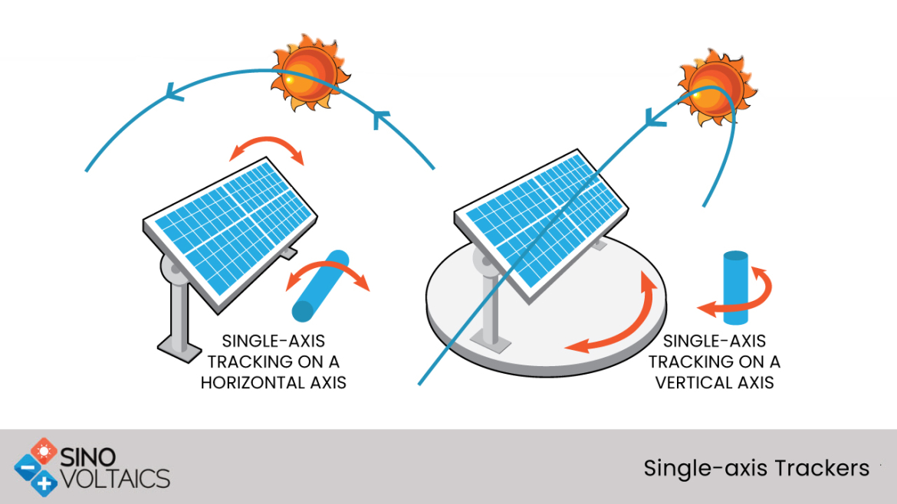
Tracking Solar Panel System
The tracking solar panel project aims to be able to follow a light source’s movement in a single axis maintaining a 90º incidence angle and therefore maximising the efficiency of the panel.
The user would interact with the demo in many ways.
The main aim of this project is to teach how the efficiency varies depending on the configuration that the solar panel is working on.

Slide 2
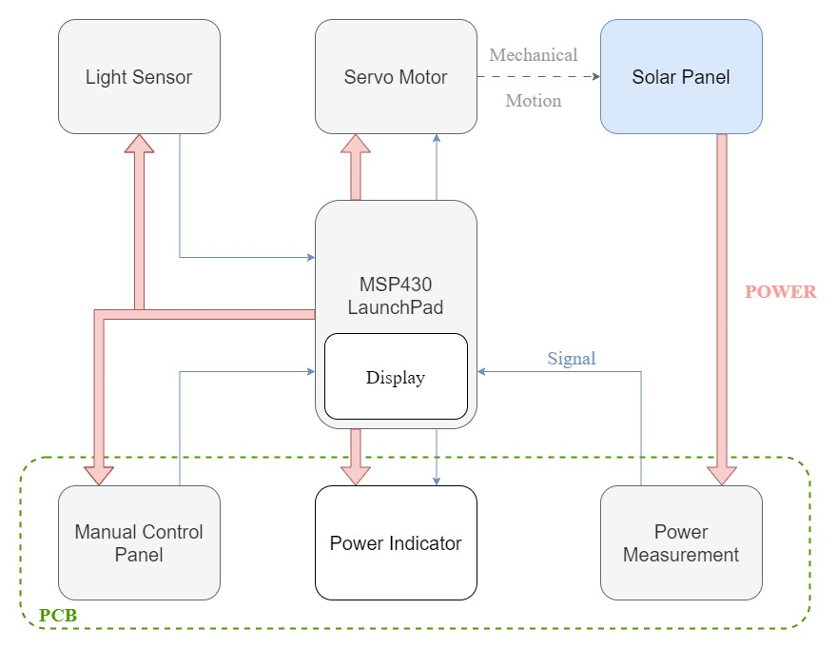
Technical Design
A tracking solar panel (using LDR)
Light source constrained to a single axis
Servo motor
Manual Control panel
Power output information display and LED indicators

Slide 3
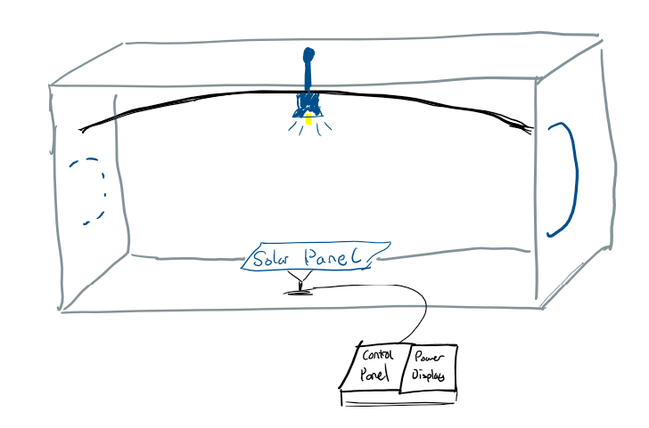
Demonstration
User can control whether the panel is fixed, manual or tracking.
They can move the light source on rail to also alter incident angle.
Power output of panel displayed to user via LCD display and LEDs.

Slide 4
Project planning
Gantt chart made showing time frame of important tasks
Tasks have been distributed among group members
Identified most important objectives, deliverables and risks.
Initial research has been started into LDR, power measurement and solar panels.

